Slide 1
Numerical Integration Methods
Fish 559; Lecture 2
Notes:
a

Slide 2
Some Preliminaries-I
Numerical methods are numerical and hence subject to various types of errors:
  Roundoff error: The consequences of a computer representing a real number using finite accuracy. Note:
    roundoff errors accumulate; and
    subtraction of two numbers that are nearly identical may lead to very large roundoff errors.
  Truncation error: the difference between the true answer and the value from the numerical analysis.

Slide 3
Some Preliminaries-II
Truncation error:
  There are often error bounds for methods (though we will not consider these in this course).
  Truncation error can be reduced by increasing the number of steps / reducing tolerances or step sizes, but this can be costly in terms of computation time and, eventually, roundoff error will begin to impact the results.

Slide 4
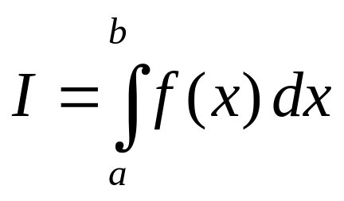

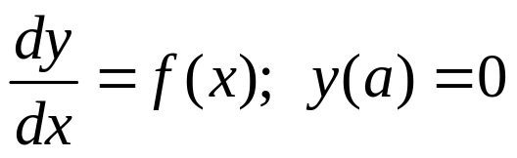
Numerical Integration
(or numerical quadrature)
The objective of numerical integration is to solve the problem:
which is equivalent to finding subject to:
We will assume that the function f cannot be integrated analytically!

Slide 5
Numerical Integration
(why do this)
The density of larvae is given by the function f (as a function of distance along a river); how many larvae are there between points a and b along the river?
Let f be the function that determines the rate of change in the number of animals of species i (which depends on the number of animals of species i). If there are 1,000 animals of species i at time t₀, how many are there at time t₀+1.

Slide 6
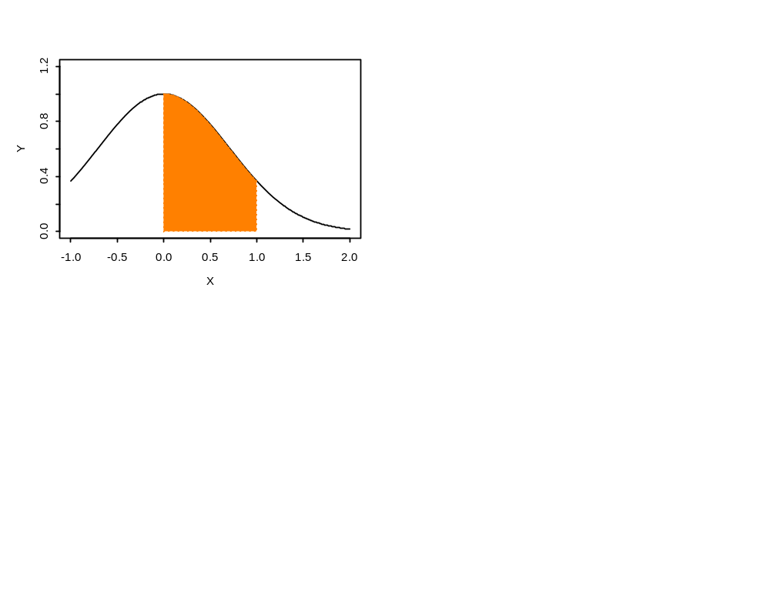
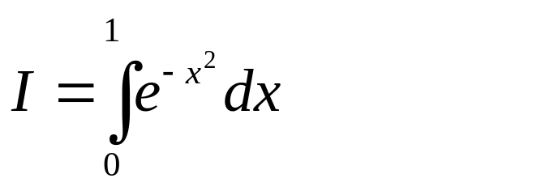
Numerical Integration
(An example problem)
We wish to evaluate the integral:

Slide 7
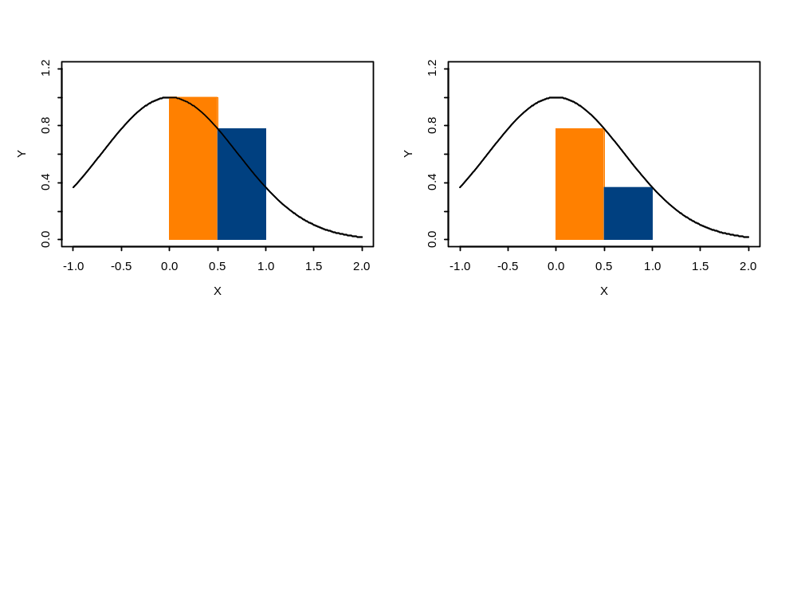
Numerical Integration
(Single-step approaches-I)
We could approximate the integral by its height at its first point, at its last point, or at the middle.
Approximating the integral by the average of the first two approaches is the “Trapezoidal rule”.

Slide 8
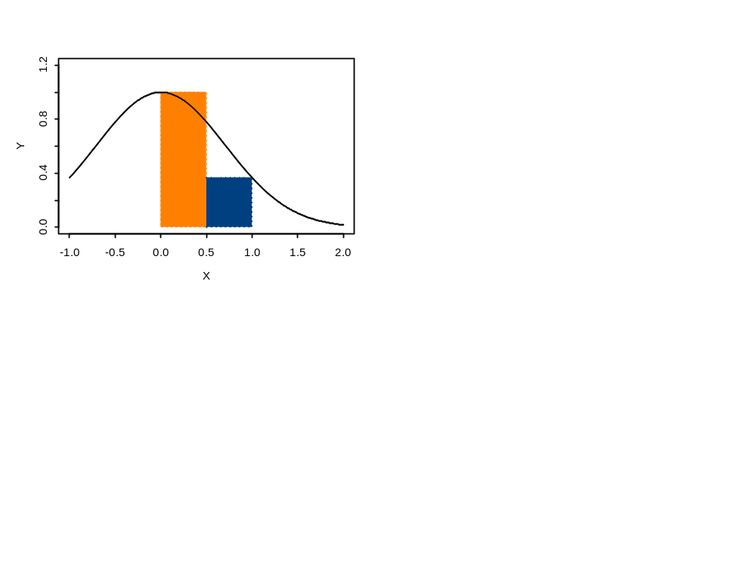
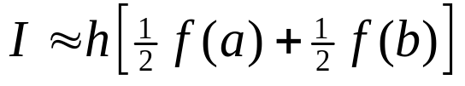

Numerical Integration
(Single-step approaches-II)
We wish to integrate from a to b. We have formulae that get more accurate as more terms are added:
Trapezoidal rule:
Simpson’s Rule:
Boole’s rule:
h is the step size. It is (b-a) divided by the number of function calls less 1.
There are many variants on this theme!
http://en.wikipedia.org/wiki/George_Boole

Slide 9
Numerical Integration
(Single-step approaches-III)
Results:
  Trapezodinal rule: 0.68394
  Simpson’s rule: 0.74718
  Boole’s rule: 0.74683
  Exact: 0.74682!

Slide 10
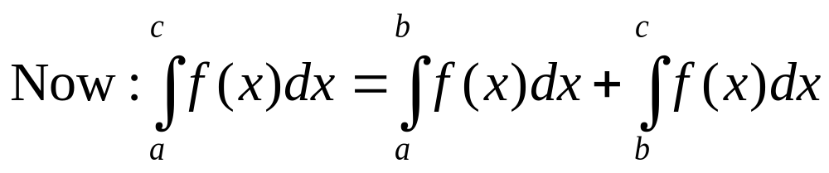
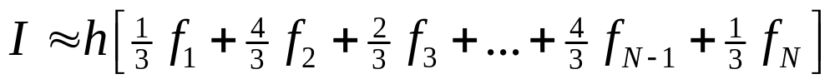
Numerical Integration
(Multi-step rules)
Therefore, in order to numerically integrate over the interval [a, c], we can apply one of the single-step rules multiple times and add the results, i.e. for Simpson’s rule:

Slide 11
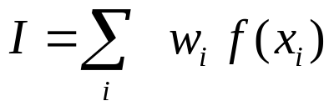
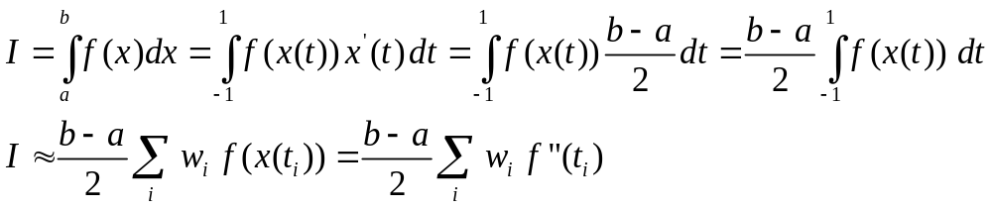
Other Approaches
(Gaussian quadrature-I)
Generalizing the previous approaches:
The previous methods have all been based on equal spacing along abscissa. We can improve our accuracy (at the expense of a bit more programming) by allowing freedom in the location of the absciccas.

Slide 12
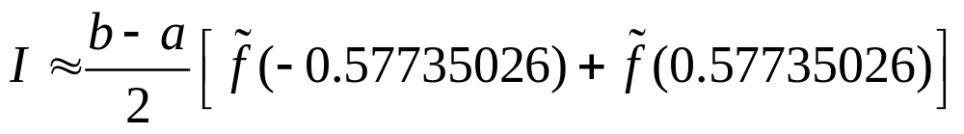
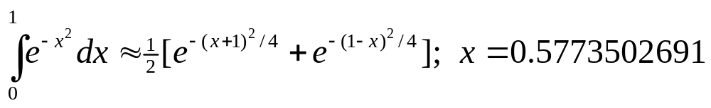
Other Approaches
(Gaussian quadrature-II)
For two point Gaussian quadrature:
This lead to an approximation to the integral of 0.74965. The three point formula leads to 0.74673.
Abramowitz and Stegun provide details on the absiccas and weights for equations of different orders (numbers of terms in the approximating equation).

Slide 13
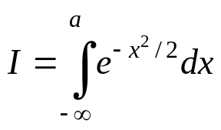
The Error Function
Perhaps the most frequently required integral in fisheries is the “error function”:
It is not necessary to apply the methods of this lecture to compute this integral because very accurate approximations to it have been programmed and are available in software libraries (e.g. NORMDIST in EXCEL, cumd_norm in ADMB and pnorm in R and TMB).
The lesson from this example, is that someone may have already solved your problem; before writing your own code check whether this is the case!

Slide 14
Multidimensional Integrals
Multidimensional integrals are much more complicated than single-dimensional integrals. There are a few basic approaches to computing these integrals:
  Split the problem into multiple single dimensional integrals.
  Use Monte Carlo methods.
  Use numerical methods (such as Laplace’s method).
The issue of computing multidimensional integrals using Monte Carlo methods will be discussed later.

Slide 15
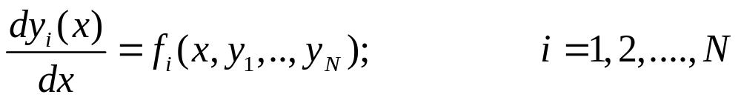
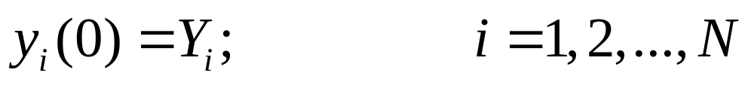
Integration of ODEs
The generic problem is the study of a set of N coupled first order differential equations:
The specification of ODEs generally includes initial conditions, i.e.:

Slide 16
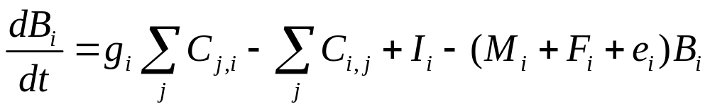
A Familiar Set of ODEs
(Ecosim)
The initial conditions are determined from Ecopath.
Net growth efficiency
Immigration
Consumption of
species j by species i
Non-predation mortality,
fishing mortality and
emigration

Slide 17
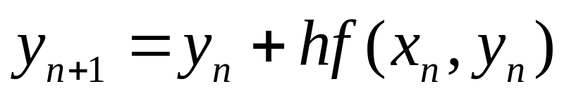
Euler’s Method
Euler’s method updates the solution from x_{n} to x_{n+1}=x_{n+h} using the formula:
This method is simple, but can be very inaccurate (unless a very small step-size is used).

Slide 18
Other Ways to Solve ODEs
Runge-Kutta methods.
Richardson extrapolation.
Predictor-corrector methods.
We will focus on the Runge-Kutta method.

Slide 19
Runge-Kutta Methods-I
These tend to perform adequately for many problems (but more efficient algorithms do exist).
The step size (h) can be monitored and modified automatically to improve performance.

Slide 20
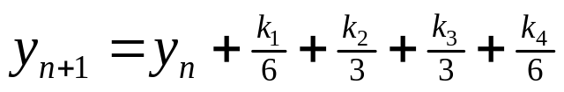
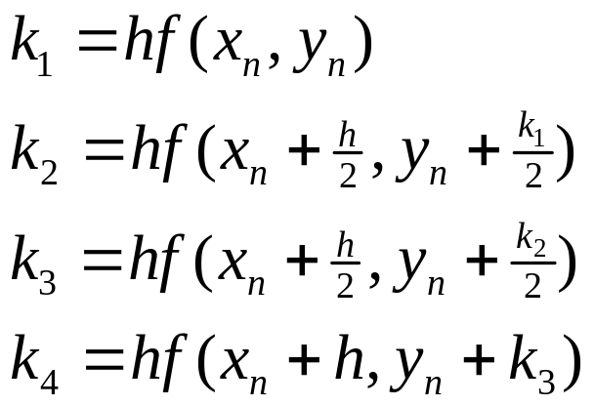
Runge-Kutta Methods-II
There are many versions of the Runge-Kutta method but the fourth-order version seems the most popular:
There are multidimensional versions of the RK algorithm.

Slide 21
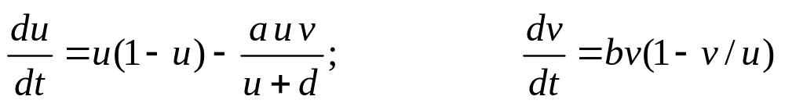
An Example-I
Solve the following ODE using (a) Euler’s method and (b) the Runge-Kutta fourth-order method:
where:

Slide 22
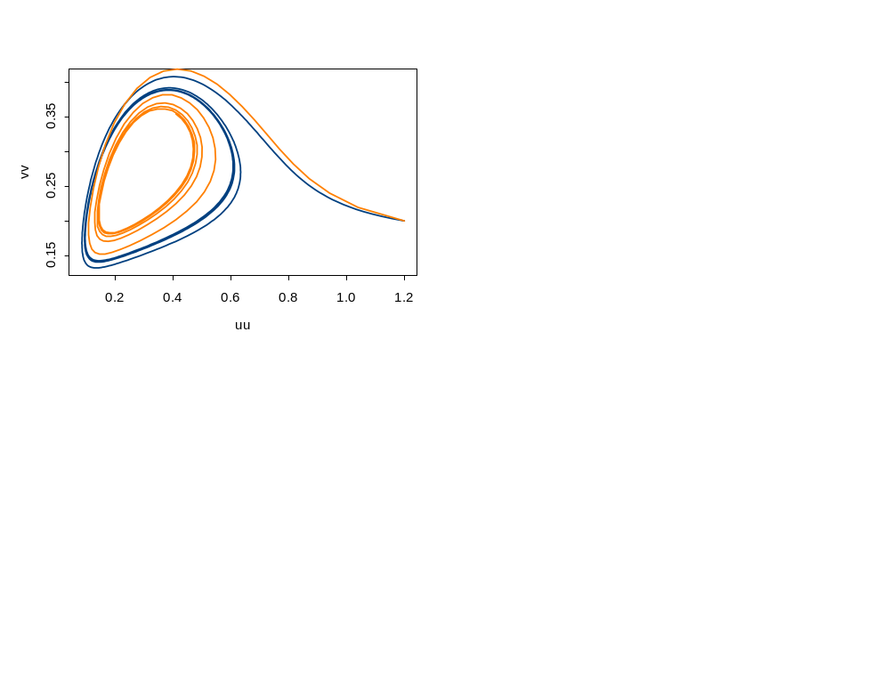
An Example -II
Runge-Kutta
Euler

Slide 23
Moving to PDEs
Partial Differential Equations (PDEs) are much more difficult to solve.
Although algorithms do exist to solve these, the literature is vast and we will not discuss them in this course.

Slide 24
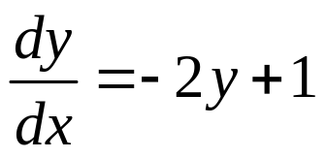
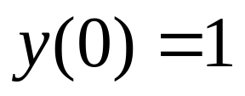
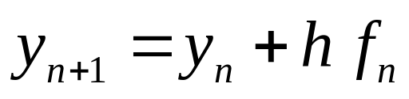
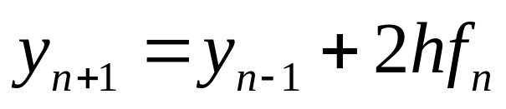
Numerical Instability-I
We wish to solve the following initial value problem:
We can apply Euler’s method:
or Milne’s method:

Slide 25
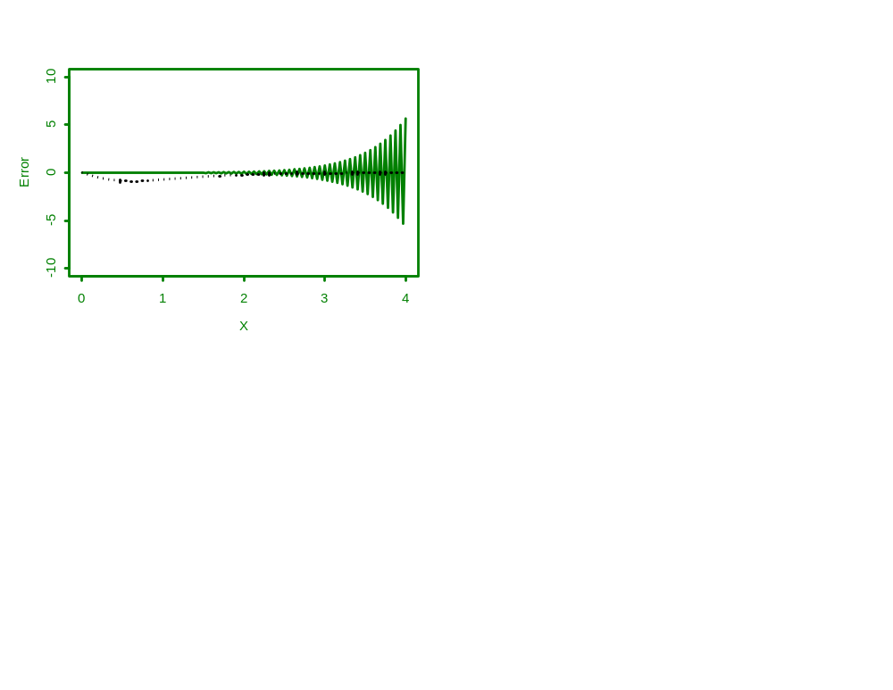
Numerical Instability-II
Euler’s method is stable but Milne’s rule
Becomes unstable after x=2!
In the case, we knew the correct solution,
what would we do in reality?

